Slide 1

Restaurant Recommendation System
Harnoor Singh

Slide 2
Agenda
Problem Statement
Datasets
Exploratory Data Analysis
Data Preparation & Data Cleaning
Recommendation Function
Result
Demo

Slide 3
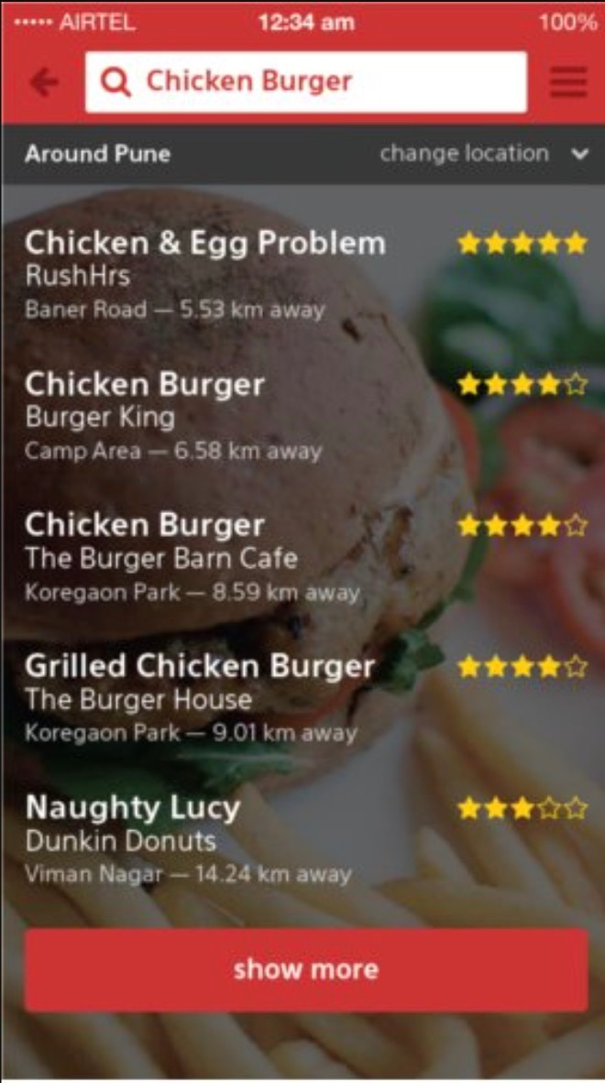
Problem & Vision
In terms of restaurants, there are too many options available for people to choose from based on their preferences.
It's always difficult for new visitors, even locals, to find the ideal restaurants that are exciting and novelty.
We aim to build a personalized prototype of restaurant recommendation system, which not only considers the interaction between customers and restaurants, but also contains metadata representing customers' personal taste and restaurant functions.

Slide 4
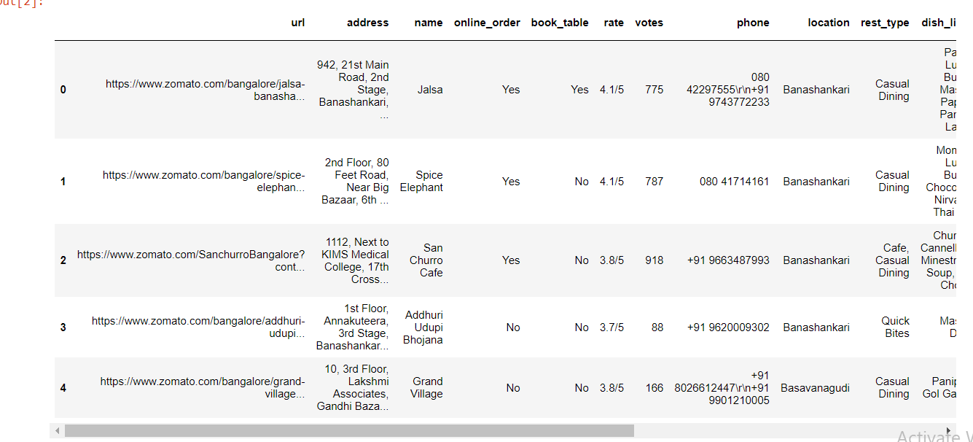
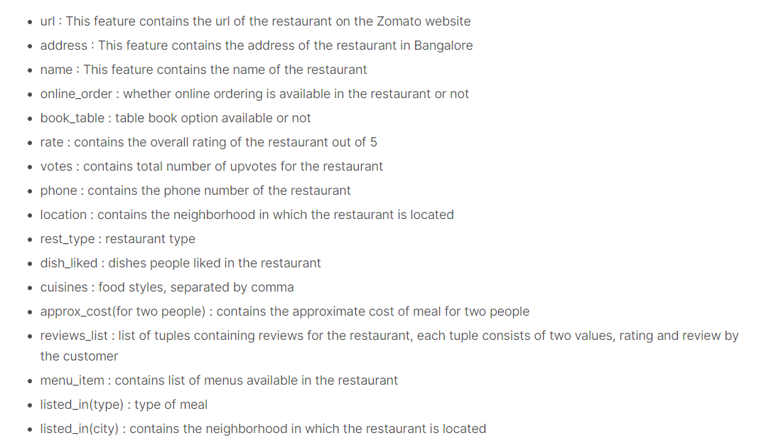
Datasets
Dataset(https://www.kaggle.com/himanshupoddar/zomato-bangalore-restaurants)

Slide 5
Exploratory Data Analysis
Dataset Business contains geographical information about 192,609 businesses, categories and attributes, such as average star rating, hours, whether they offer parking etc.
Dataset review includes 6,685,900 review texts and ratings users write to businesses.

Slide 6
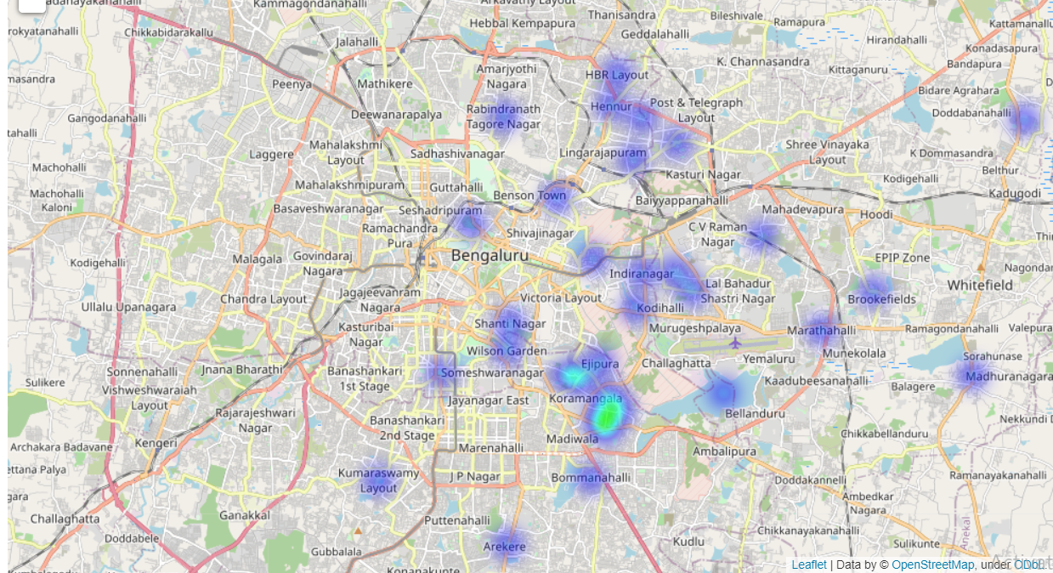
Exploratory Data Analysis
Business :-
Zomato dataset is majorly of bangalore

Slide 7
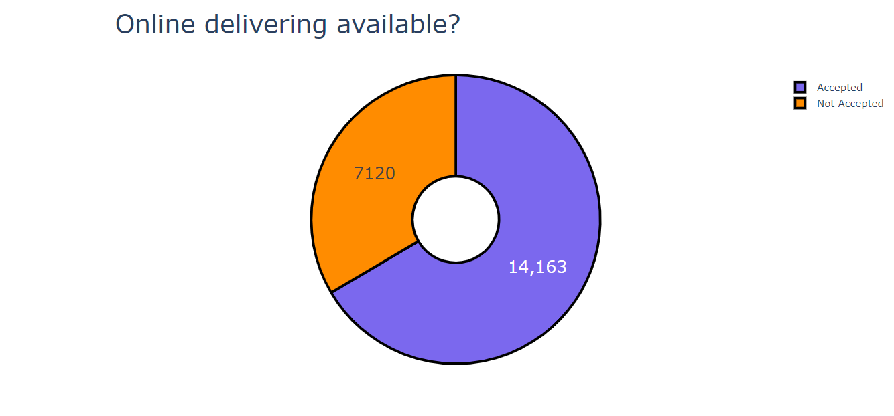
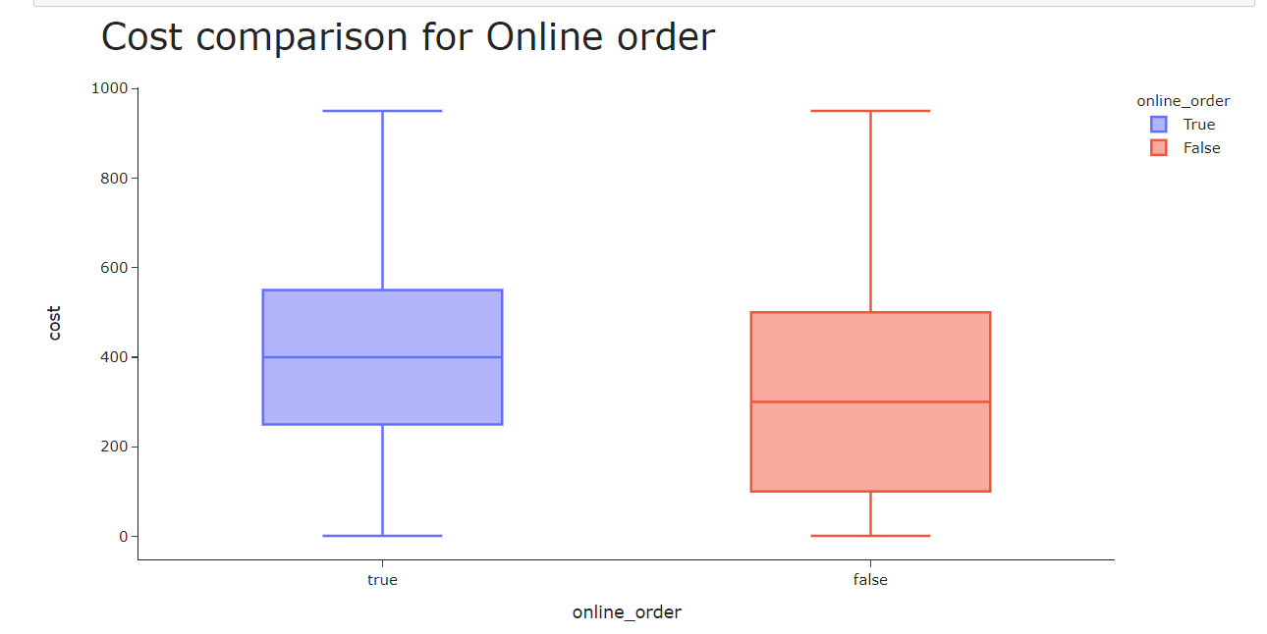
Exploratory Data Analysis
Business :-
The yelp business dataset consists of variety of different businesses indicated by the column ‘attributes’
Number of entries for the category ‘Restaurants’ was the highest.

Slide 8
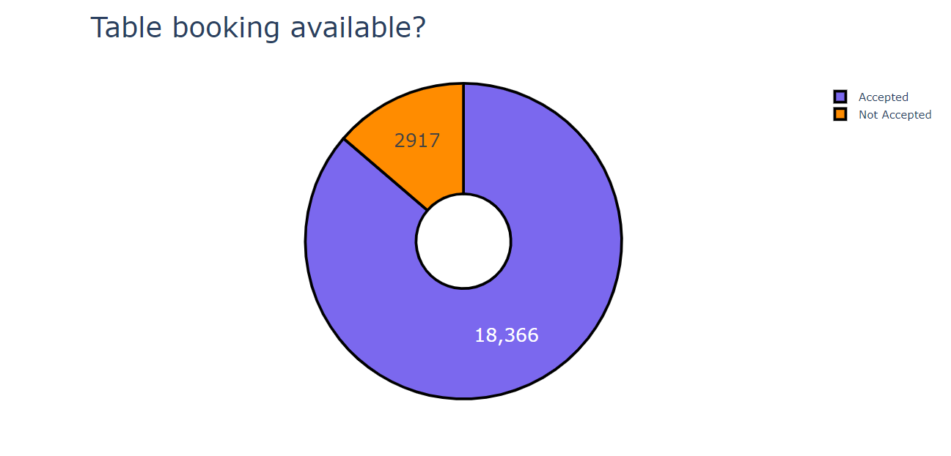
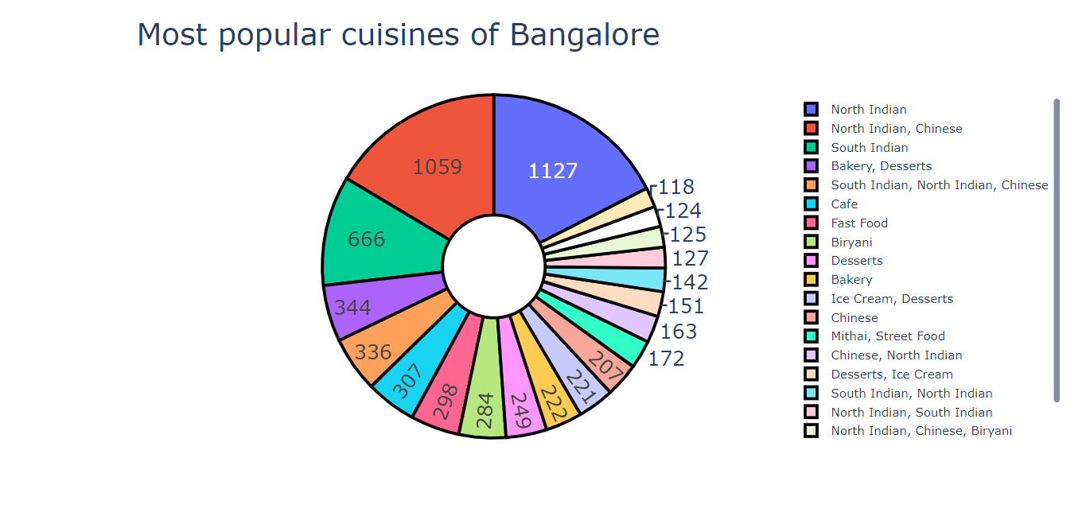
Exploratory Data Analysis
Users :-
From the correlation matrix, we observe that there exists high correlation between variables due to multi-component ratings
USERS CORRELATION MATRIX

Slide 9
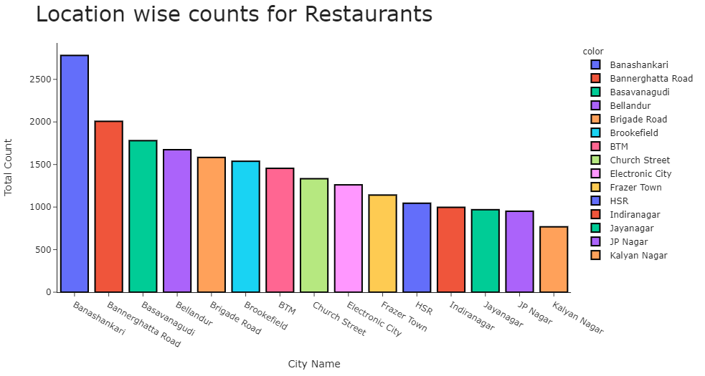
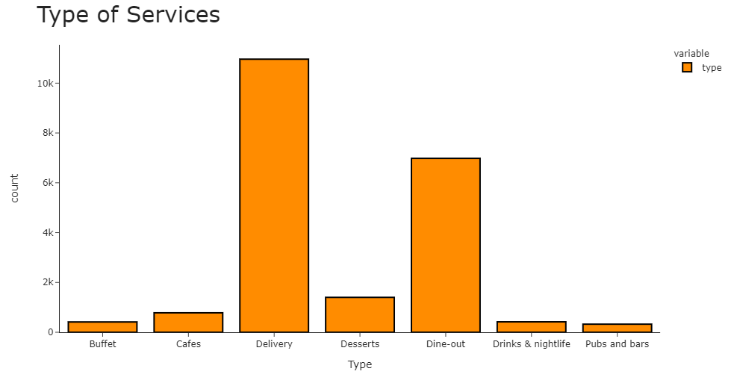
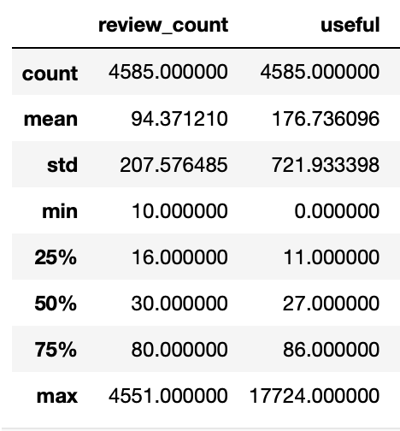
Exploratory Data Analysis
Users :-
There are outliers observed in the value of review_count in the user's dataset
Notes:
Whether it is Illinois specific?

Slide 10
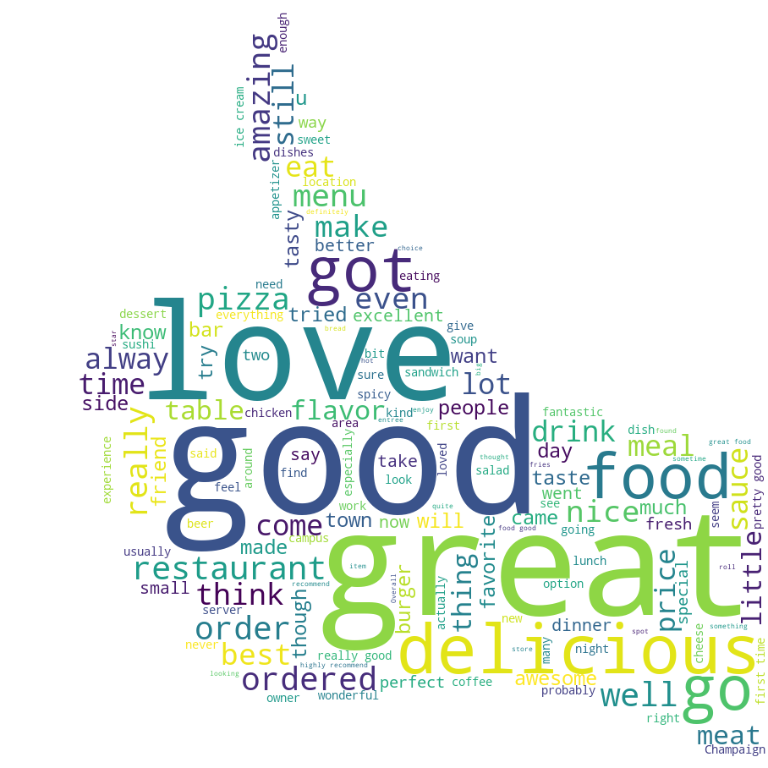
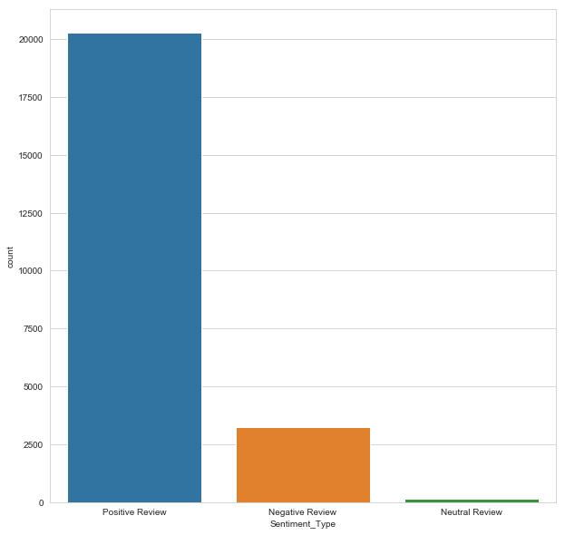
Exploratory Data Analysis
Review :-
We have performed sentiment analysis on the review dataset text
People seem to be more likely to write a review for a positive experience than a negative one
Notes:
Using the nltk, we have performed sentiment analysis
Mention there is no empty strings in the text

Slide 11
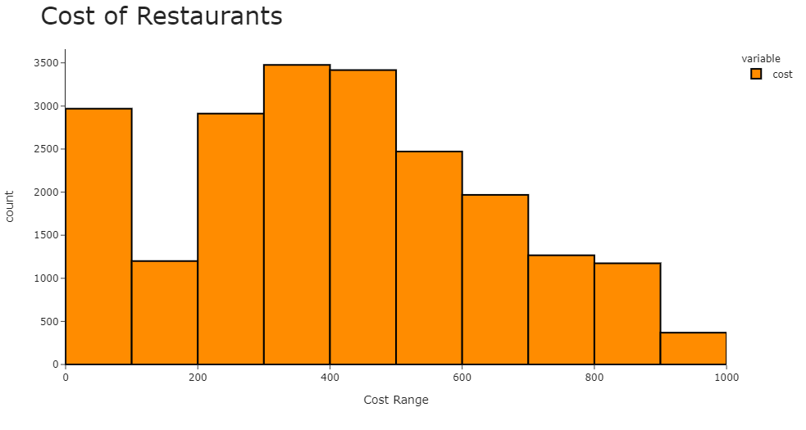
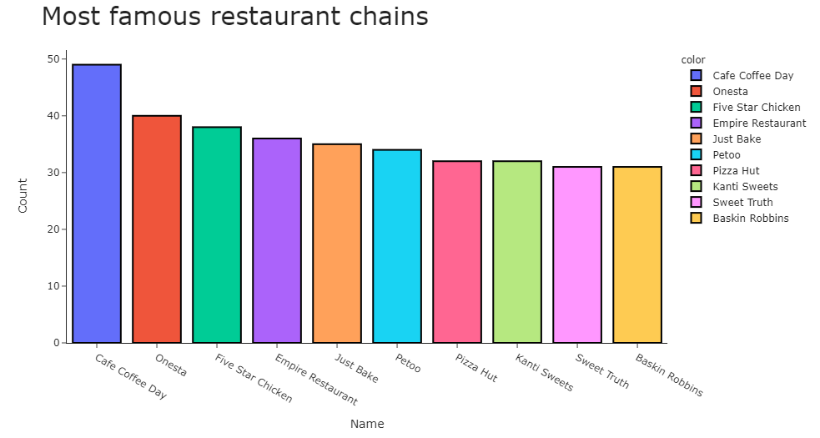
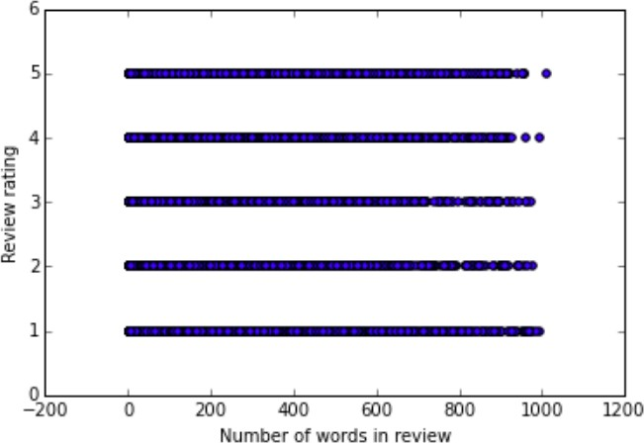
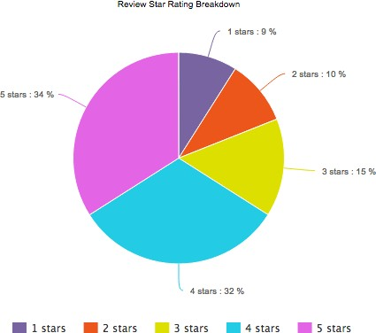
Exploratory Data Analysis
Review :-
The yelp reviews dataset consists of ratings provided by the user out of 5 stars.
Most of the users have given more positive ratings to the restaurants.

Slide 12
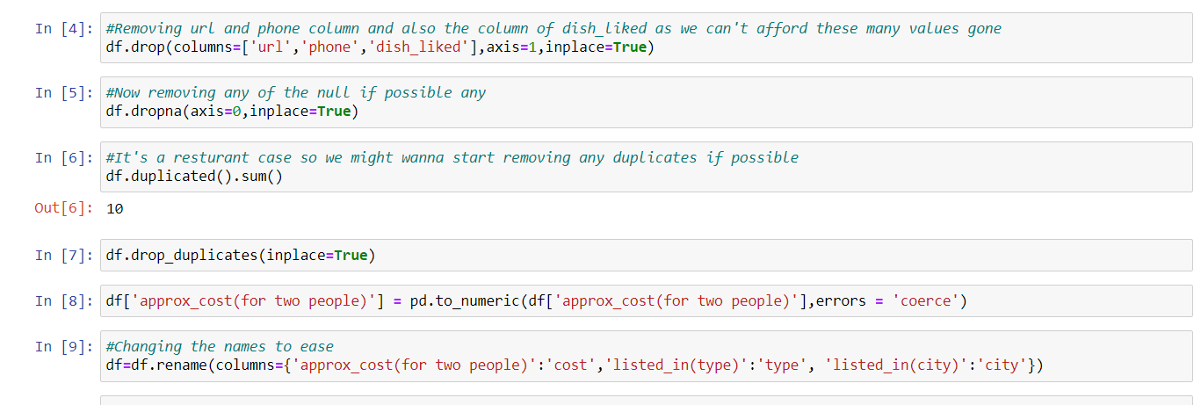
Data Cleaning
Business :-
It was found that there are duplicate entries, as there are no recurring business ids
Spelling correction for the city variable better name of coloums

Slide 13
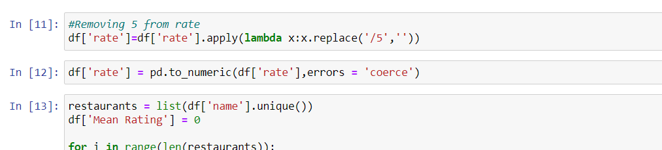
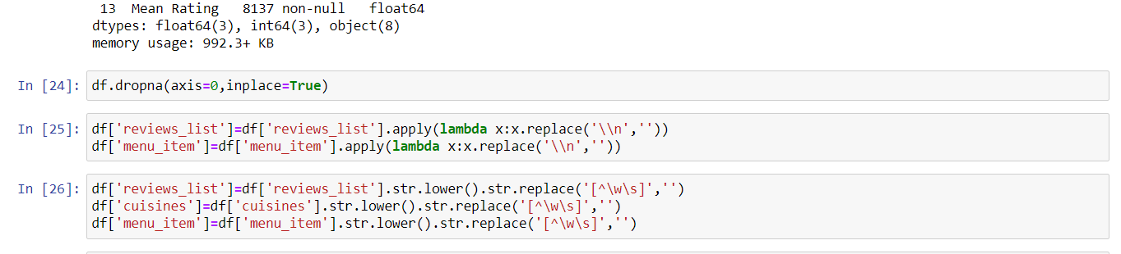
Data Cleaning
We remove the white spaces from cols review list, menu list, cuisines, and menu item for the ease.
We /5 from all the rate col.

Slide 14
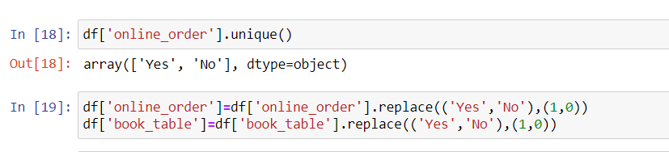
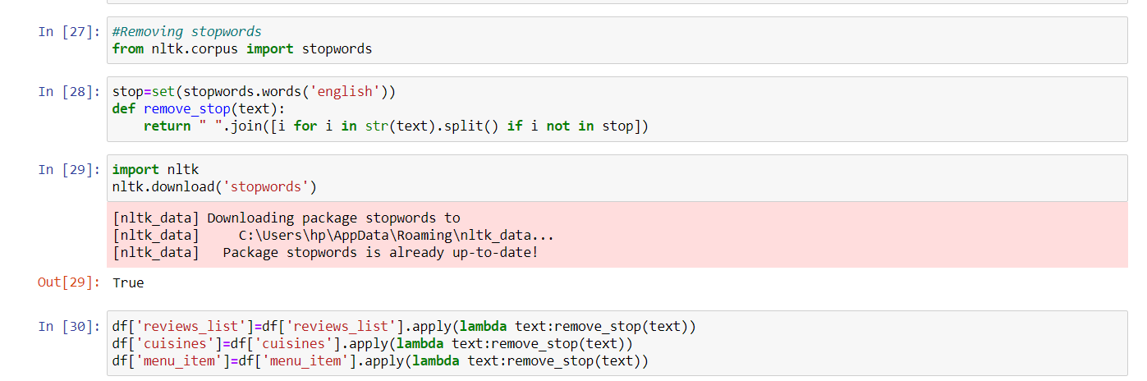
Data Preparation
Removed stopwords and encoding on online order and book table .

Slide 15
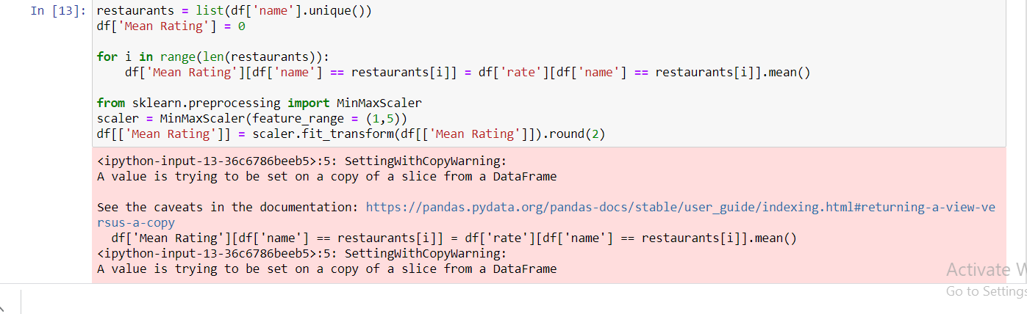
Data Preparation
Adding a new col mean rating for a restaurant.
Notes:
- We cannot state Illinois exploration in eda, we can call it in data preparation after we have declared that we will be focusing on illinois

Slide 16
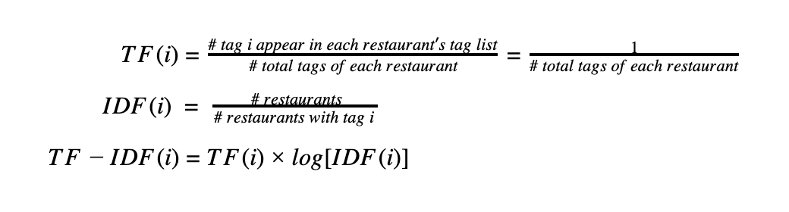
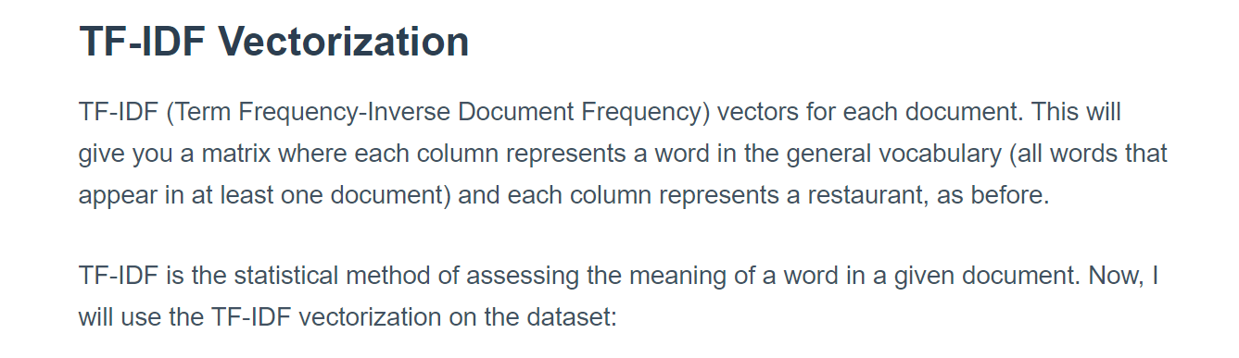
Data Preparation
Users :-
Computed TF-IDF for each tag which will be used
as weights during model fitting
Notes:
Review
The reasoning for this transformation is that we want to focus more on ranking the user liked restaurants and disliked restaurants in the correct order, rather than predicting user ratings on each restaurant, which would result in high variance over time.

Slide 17
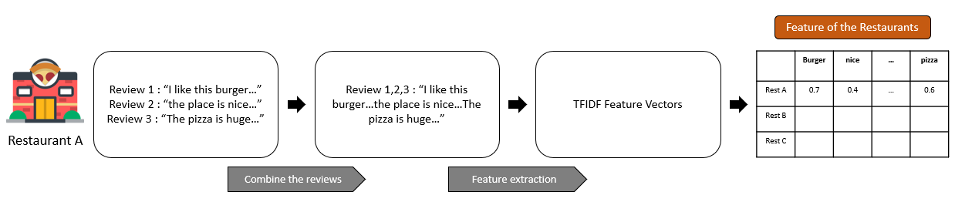
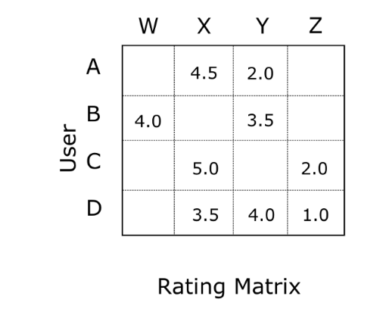
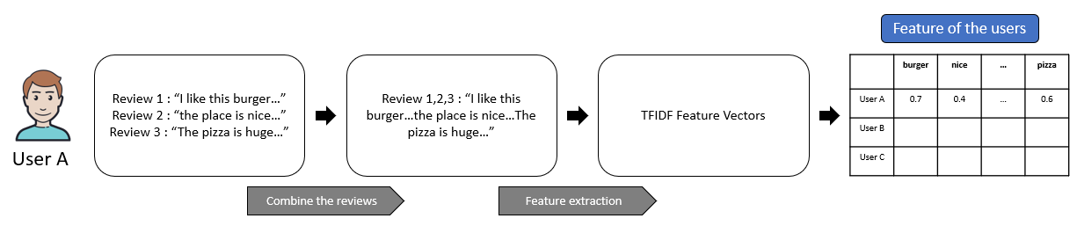
Data Preparation
Interaction Matrix :-
Using past interactions recorded between users and restaurants, we create interaction matrix
This helps in detecting similar users and/or Similar restaurant
Sparsity: 99.67%
Restaurant

Slide 18

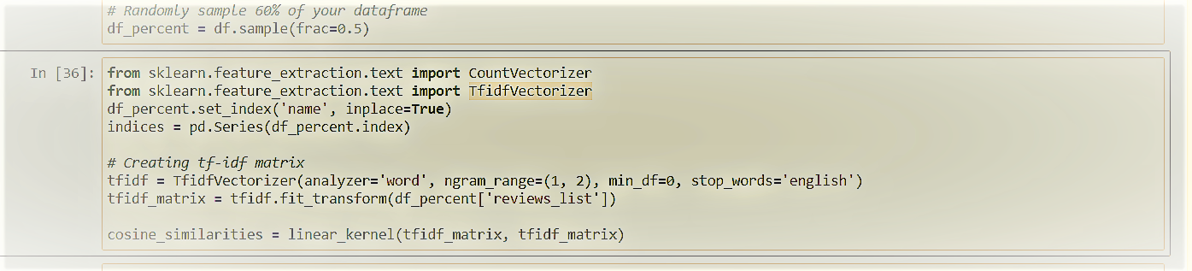
Recommendation Function
A Recommendation System refers to a system that can predict the future preference of a set of restaurants for a user
Notes:
We aim to build a personalized prototype of restaurant recommendation system, which not only considers the interaction between customers and restaurants, but also contains metadata representing customers' personal taste and
We didn’t use Content based filtering because it doesn’t consider interactions between users and items which can open up new options for users other than it’s past choices.

Slide 19
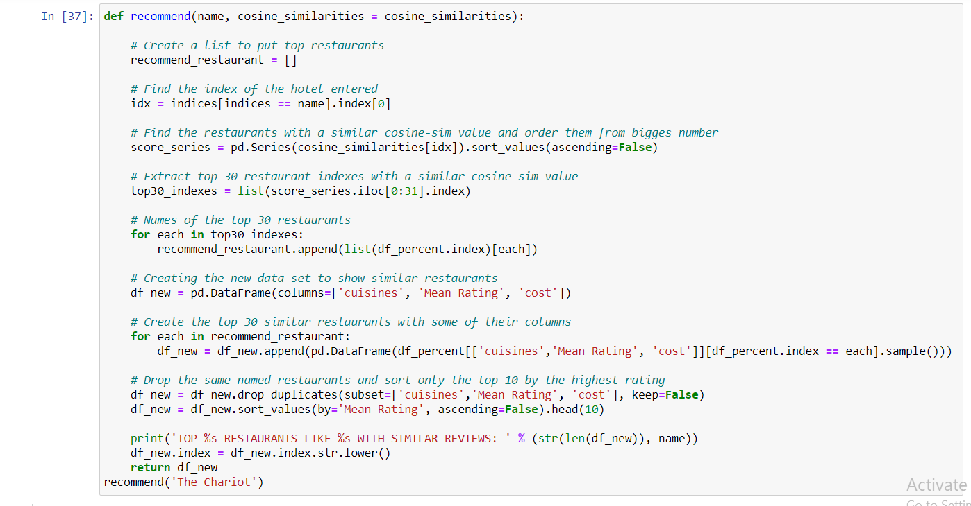
Function
Notes:
Positive item – means there is a match between the recommended restaurant and a restaurant liked by the user
https://stackoverflow.com/questions/45451161/evaluating-the-lightfm-recommendation-model

Slide 20
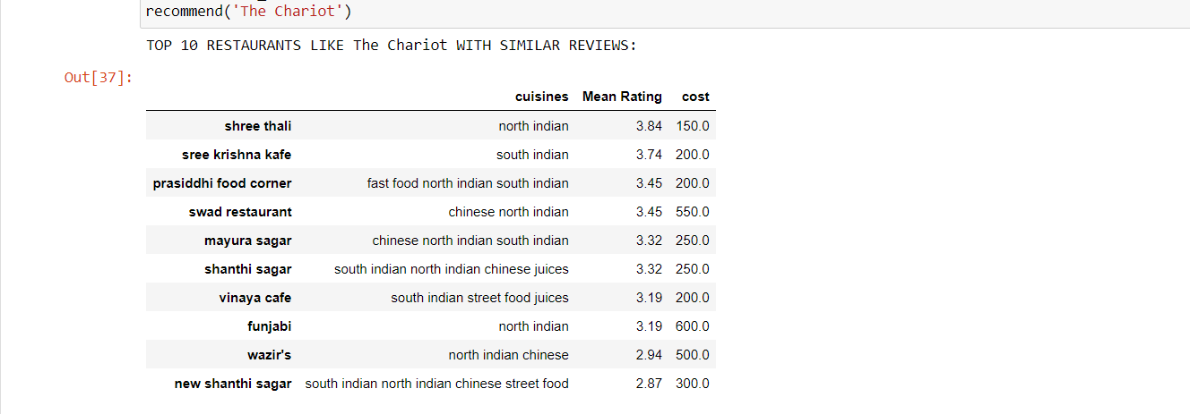
Results

Slide 21
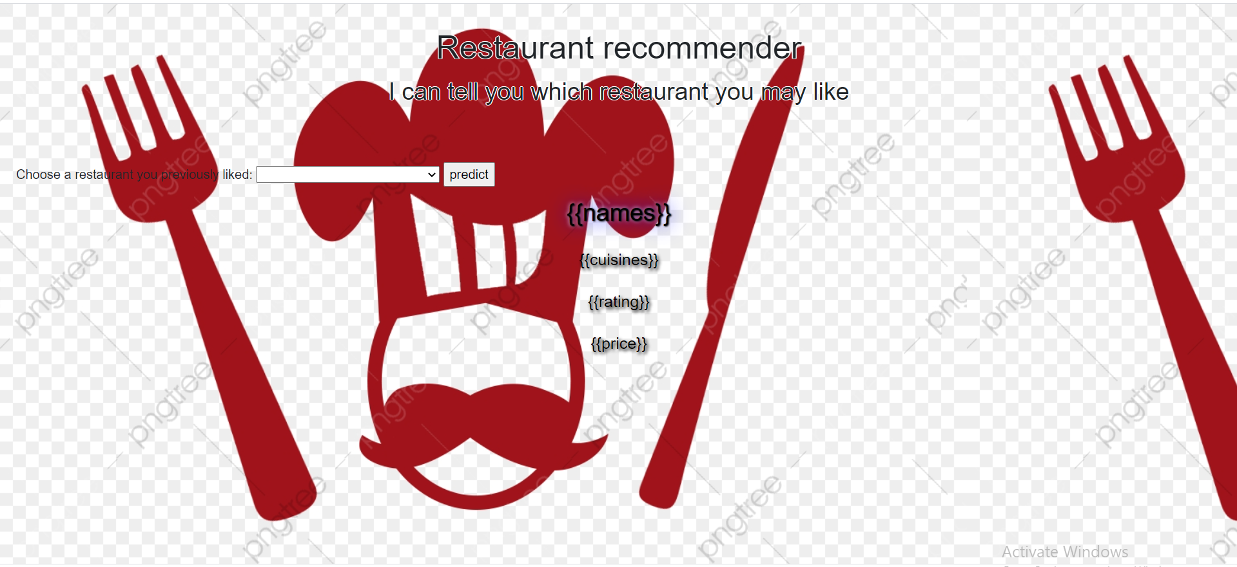
Demo

